Slide 1

Pushdown Automata: Definitions Moves Instantaneous descriptions Deterministic pushdown automata-Problems related to DPDA Non - Deterministic pushdown automata-Problems related to NDPDA Pushdown automata to CFL Equivalence-Problems of PDA to CFG CFL to Pushdown automata Equivalence Problems related to Equivalence of CFG
UNIT-3

Slide 2
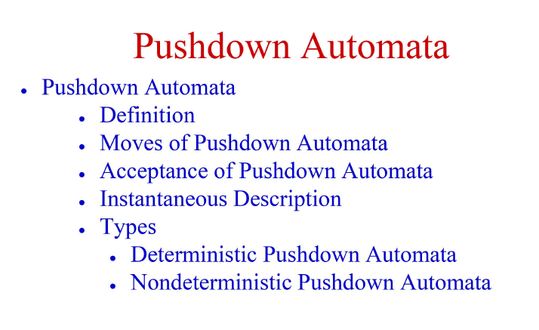
Pushdown Automata: Definitions Moves

Slide 3
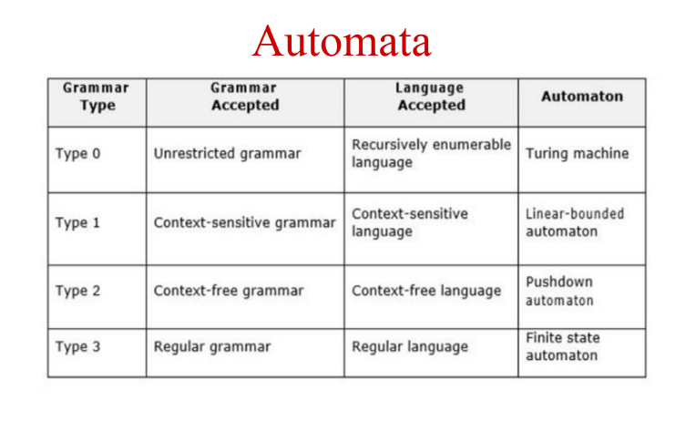

Slide 4
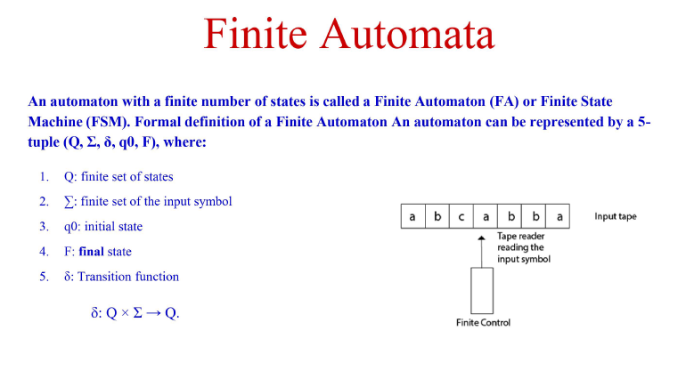

Slide 5
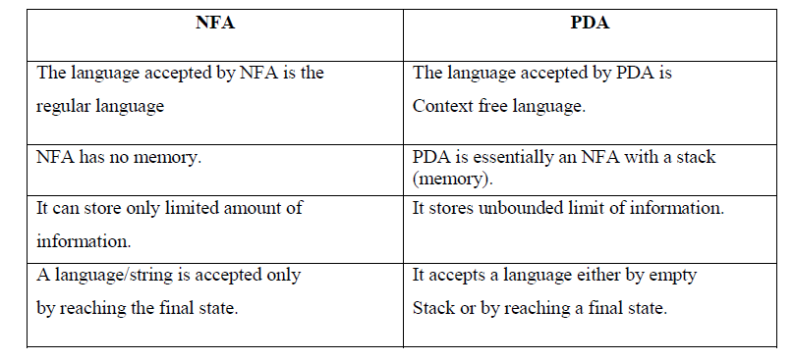
NFA Vs PDA: Definitions

Slide 6
Pushdown Automata: Definitions
A PDA is a computational machine to recognize a Context free language.The PDA has a finite control , and the memory is organized as a stack.
FA+stack = PDA

Slide 7
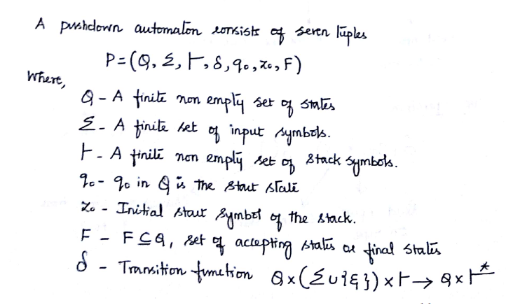
Pushdown Automata: Definitions Conti….

Slide 8
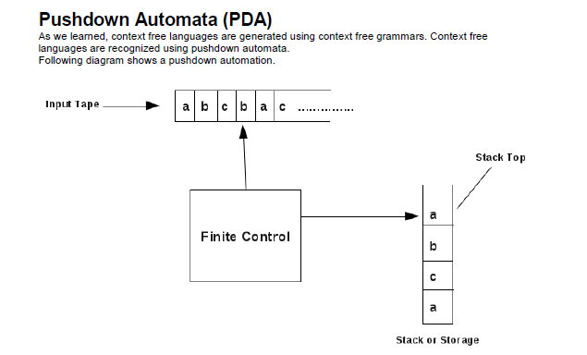
Basic Structure of PDA
A PDA has three components −
an input tape,
a control unit, and
a stack with infinite size.
The stack head scans the top symbol of the stack.
A stack does two operations −
Push − a new symbol is added at the top.
Pop − the top symbol is read and removed.

Slide 9
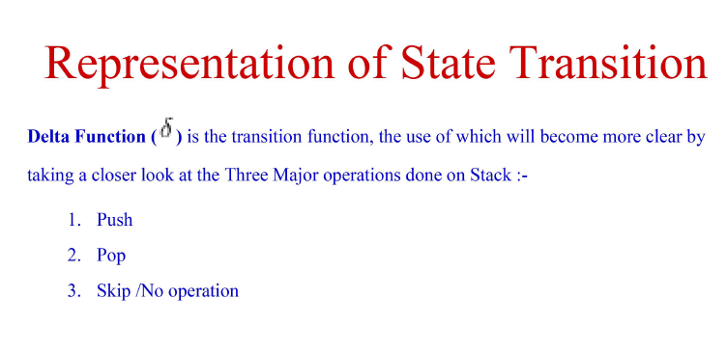

Slide 10
Language Acceptability by PDA
The input string is accepted by the PDA if:
The final state is reached .
The stack is empty.
For a PDA M=(Q, Σ ,Ґ ,δ ,q0 ,Z0 ,F ) we define : Language accepted by final state L(M) as:
{ w | (q0 , w , Z0 ) |--- ( p, Є , γ ) for some p in F and γ in Ґ * }.
Language accepted by empty / null stack N(M) is:
{ w | (q0,w ,Z0) |----( p, Є, Є ) for some p in Q}.

Slide 11
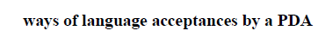
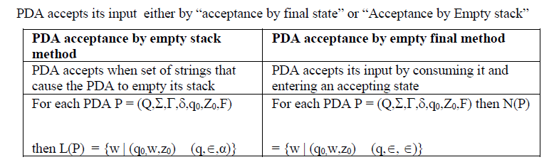

Slide 12
Instantaneous Description
ID describe the configuration of a PDA at a given instant.ID is a triple such as
(q, w ,γ ) , where q is a state , w is a string of input symbols and γ is a string of stack symbols.
Instantaneous Description (ID) is an informal notation of how a PDA “computes” a input string and make a decision that string is accepted or rejected.
The relevant factors of pushdown configuration notation by a triple (q, w, γ) where;
q is the current state of the control unit
w is the unread part of the input string or the remaining input alphabets
γ is the current contents of the PDA stack.
Such a triple notation is called an instantaneous description or ID of the pushdown automata.
It is also useful to represent as part of the configuration the portion of the input that remains.

Slide 13
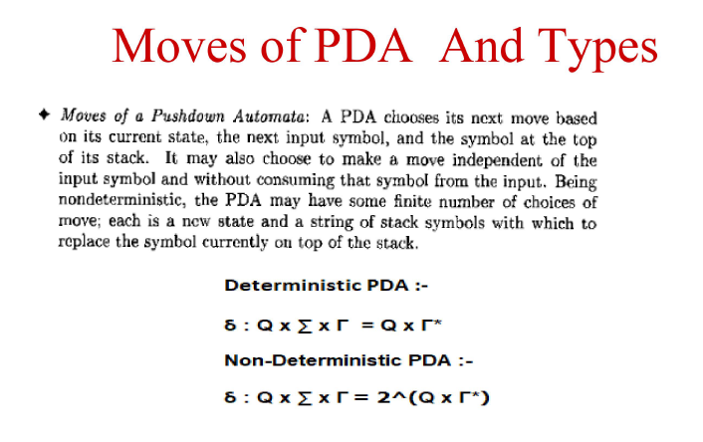

Slide 14
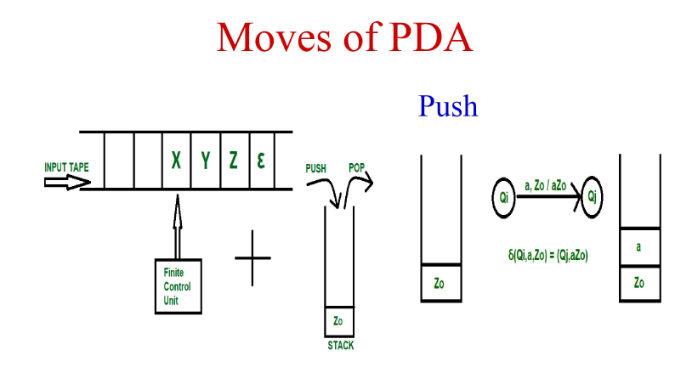
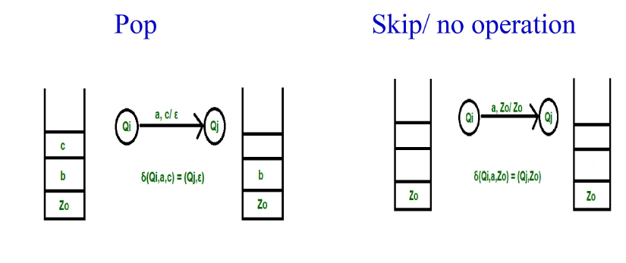
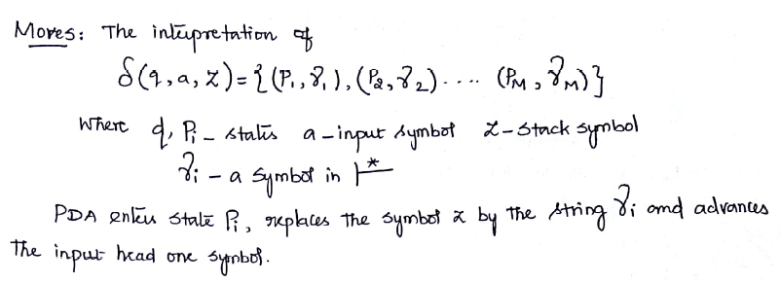

Slide 15
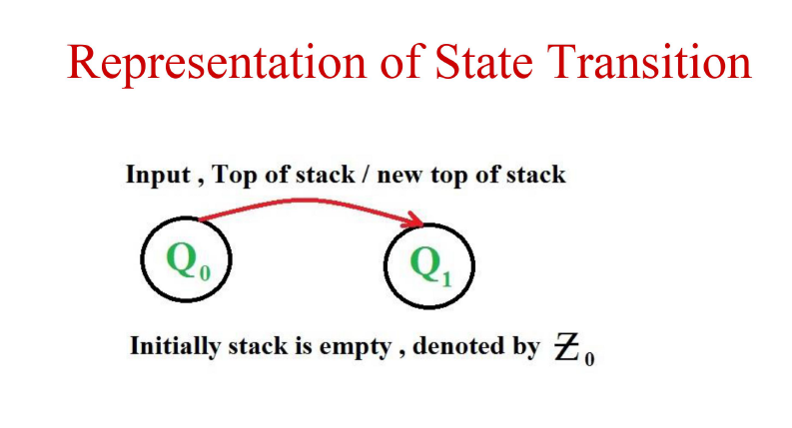
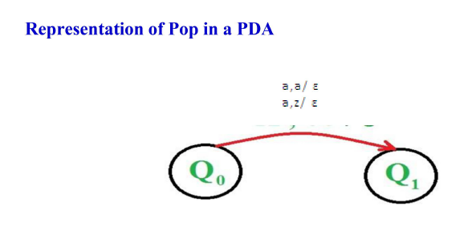
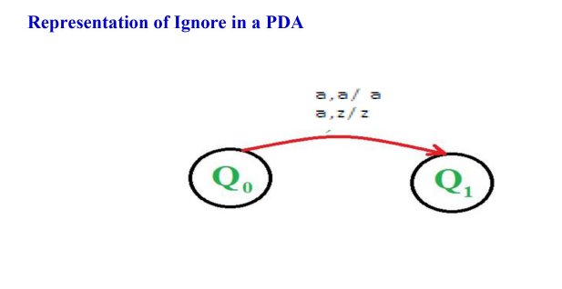
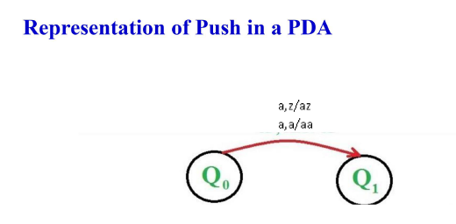

Slide 16
Give examples of languages handled by PDA.
L={ a^{n}b^{n} | n>=0 },here n is unbounded , hence counting cannot be done by finite memory. So we require a PDA ,a machine that can count without limit.
L= { ww^{R} | w Є {a,b}* } , to handle this language we need unlimited counting capability .

Slide 17
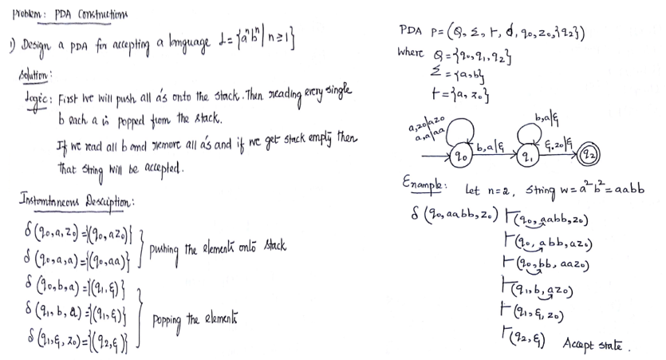
Ex:1

Slide 18
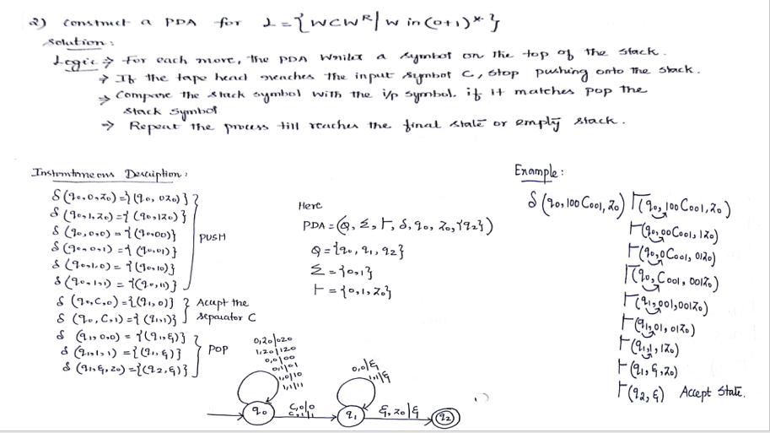
Ex:2

Slide 19
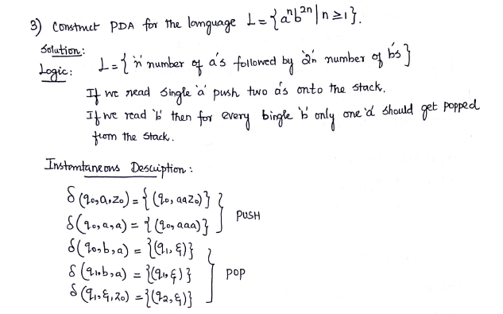
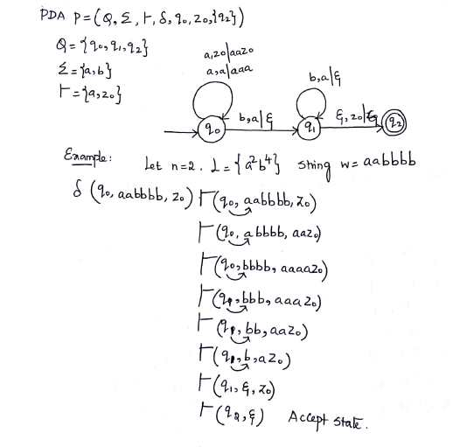
Ex:3

Slide 20
Assignment Exercises:

Slide 21
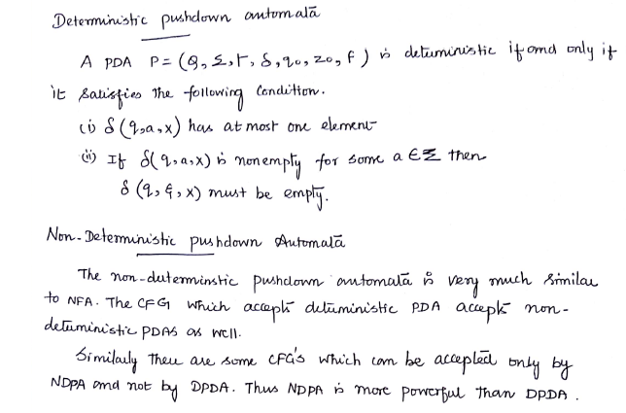
Deterministic pushdown Automata

Slide 22
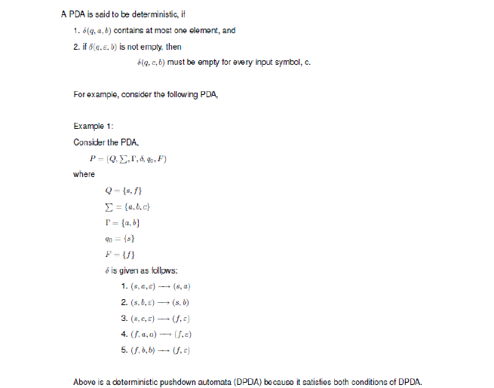
Deterministic pushdown automata-Problems related to DPDA

Slide 23
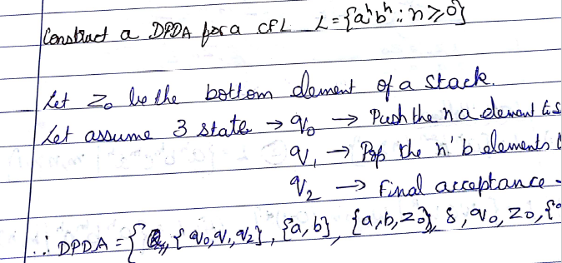
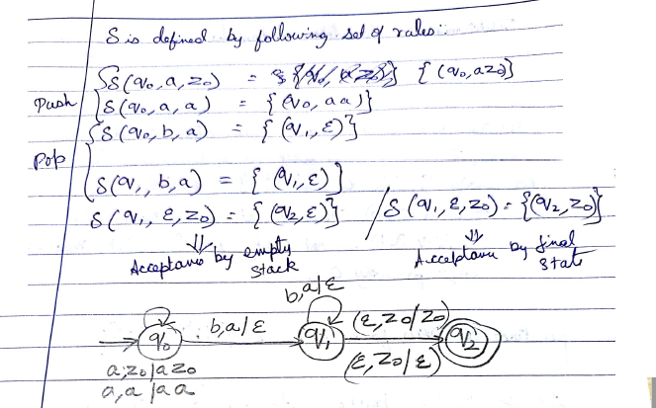
Deterministic pushdown automata-
Problems related to DPDA

Slide 24
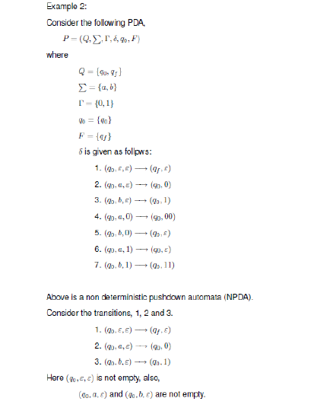
Deterministic pushdown Automata-
Problems related to DPDA

Slide 25
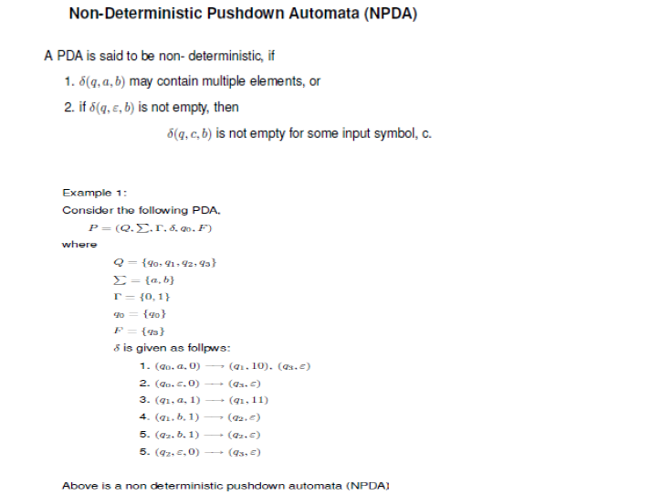
NDPDA-Problems related to DPDA

Slide 26
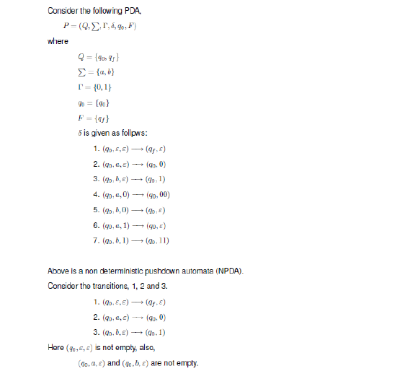
NDPDA-Problems related to DPDA

Slide 27
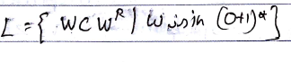
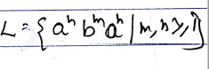
Assignment Exercises:

Slide 28
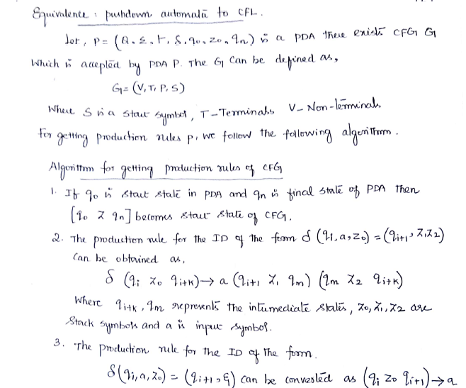
Pushdown automata to CFL

Slide 29
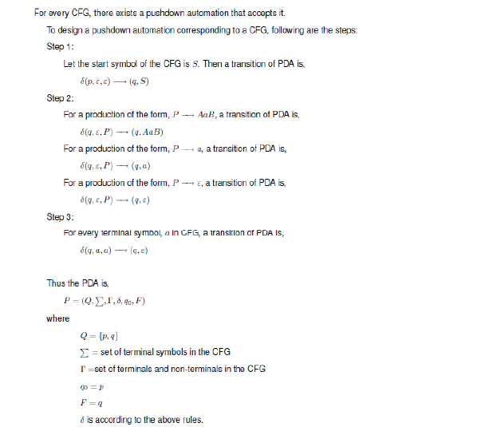
Pushdown automata to CFL

Slide 30
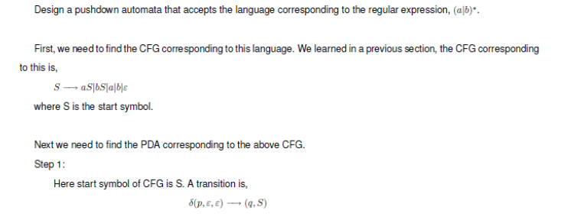
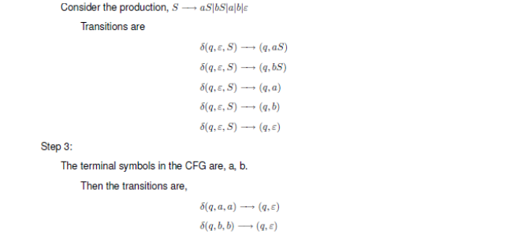
Pushdown automata to CFL Equivalence-Problems of PDA to CFG

Slide 31
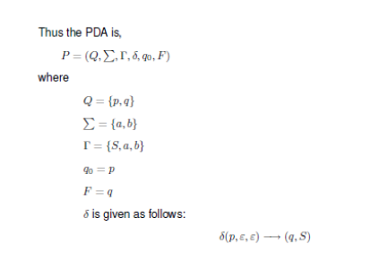
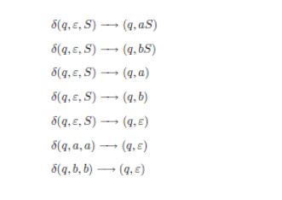
Pushdown automata to CFL Equivalence-Problems of PDA to CFG

Slide 32
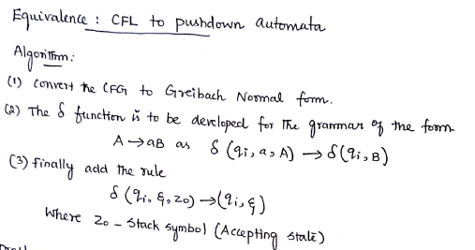
CFL to Pushdown automata Equivalence

Slide 33
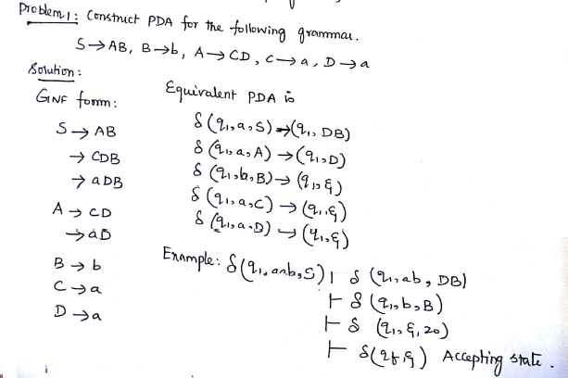
CFL to Pushdown automata Equivalence
-Problems

Slide 34
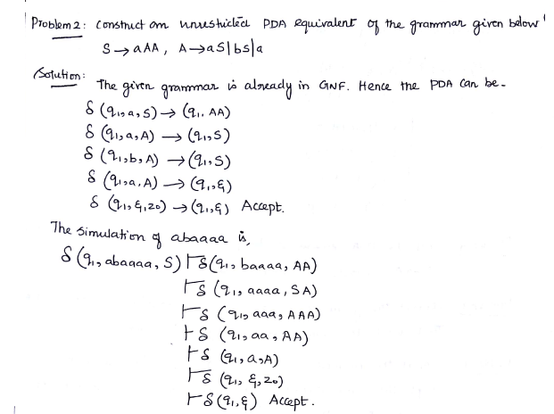
CFL to PDA - Problems

Slide 35
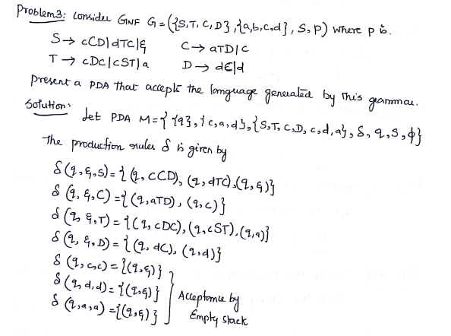
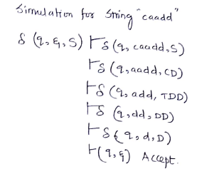
CFL to PDA - Problems

Slide 36
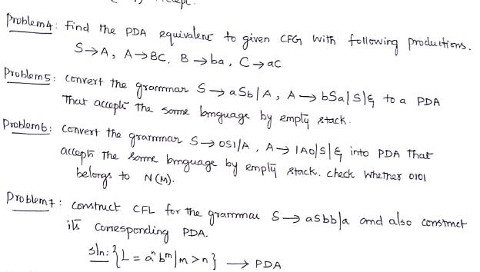
Assignment Exercises:

Slide 37
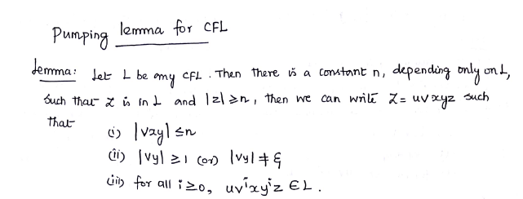

Slide 38
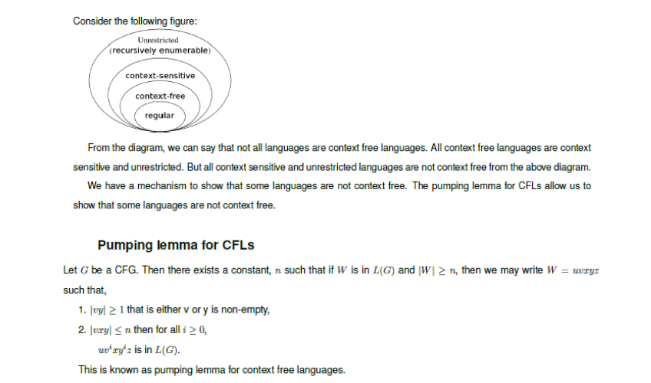

Slide 39
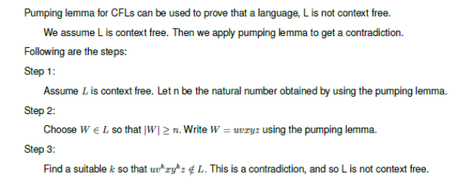

Slide 40
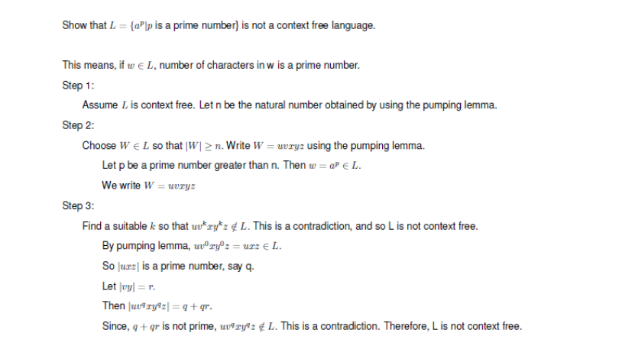
Ex:1

Slide 41
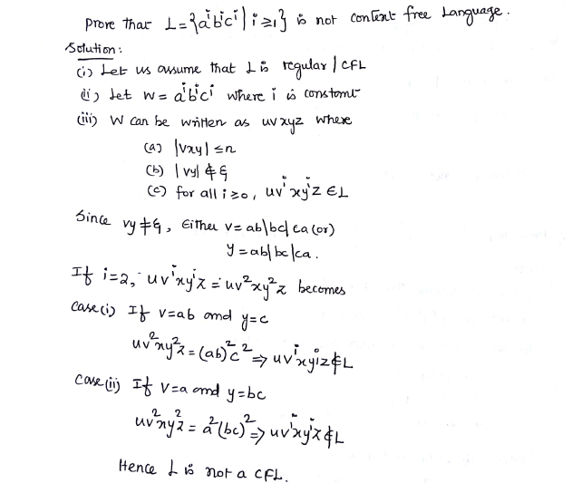
Ex:2

Slide 42
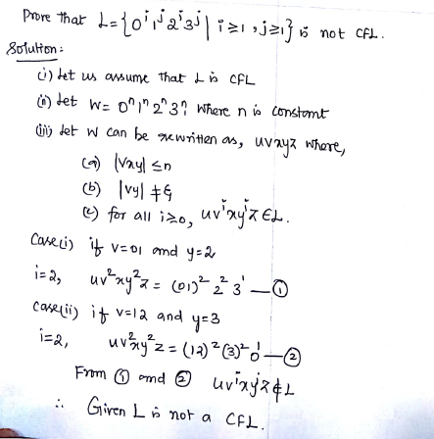
Ex:3

Slide 43
End OF UNIT-III

